Slide 1




Slide 2


Slide 3

Workshop overview
1. Introduction
2. Exploring stigma and factors that contribute to stigma
3. Strategies reduce stigma and discuss sexual health, substance use and STBBIs
4. Closing

Slide 4

Learning objectives
Increase knowledge of the various forms of stigma and the many factors that may contribute to STBBI-related stigma, including attitudes, values, and beliefs.
Increase ability to reflect on societal attitudes, values, and beliefs related to STBBIs, substance use and sexuality.
Enhance skills in discussing STBBIs, sexual health and harm reduction while using the Discussing sexual health, substance use and STBBIs: A guide for service providers (including enhanced skills in using a trauma- and violence-informed care approach in a non-stigmatizing, empowering and authentic manner).
Increase awareness of how to develop a personal action plan for the delivery of safe and inclusive STBBI-related services.

Slide 5

Learners' rights
Participate
Pass
Privacy
Respect
Fun!

Slide 6

Key terms
STBBIs
Sex-positivity
Harm reduction
Trauma- and violence-informed care

Slide 7
What is trauma-informed care?
“In trauma-informed services, safety and empowerment for the service user are central, and are embedded in policies, practices, and staff relational approaches. Service providers cultivate safety in every interaction and avoid confrontational approaches. Trauma-informed approaches are similar to harm-reduction-oriented approaches, in that they both focus on safety and engagement.”
Reference: Trauma-informed practice guide, BC Provincial Mental Health and Substance Use Planning Council, 2013, available at
http://bccewh.bc.ca/wp-content/uploads/2012/05/2013_TIP-Guide.pdf

Slide 8

What is trauma-informed care?
“A key aspect of trauma-informed services is to create an environment where service users do not experience further traumatization or re-traumatization (events that reflect earlier experiences of powerlessness and loss of control) and where they can make decisions about their treatment needs at a pace that feels safe to them.”
Reference: Trauma-informed practice guide, BC Provincial Mental Health and Substance Use Planning Council, 2013, available at
http://bccewh.bc.ca/wp-content/uploads/2012/05/2013_TIP-Guide.pdf

Slide 9
What is trauma- and violence-informed care (TVIC)?
TVIC expands on the concept of TIC to acknowledge the broader social and structural conditions that impact people’s health, including institutional policies and practices. Talking about sexuality and substance use within service settings can be difficult; using a TVIC approach helps ensure that the broader structural and social conditions are acknowledged and that organizational policies and practices as well as provider practices do not contribute to re-traumatization.
Example TVIC strategies:
acknowledging the effects of historical and structural conditions;
seeking client input about safe and inclusive strategies;
encouraging client empowerment in relation to treatment options and adoption of harm reduction strategies; and
implementing policies and processes that allow for flexibility and encourage shared decision-making.
Reference: Varcoe CM, Wathen, CN, Ford-Gilboe, M, Smye, V, Browne, A. VEGA briefing note on trauma- and violence-informed care. VEGA Project and PreVAiL Research Network. 2016

Slide 10

Activity
The language of sex

Slide 11

Activity: Name the substance

Slide 12

Stigma
What is it?
Where do we see it?
What is the impact?

Slide 13

Stigma defined
Perceived stigma: an individual's awareness of negative societal attitudes, fear of discrimination and feelings of shame.
Internalized stigma: an individual’s acceptance of negative beliefs, views and feelings towards the stigmatized group they belong to and oneself.
Enacted stigma: encompasses overt acts of discrimination, such as exclusion or acts of physical or emotional abuse; acts may be within or beyond the purview of the law and may be attributable to an individual’s real or perceived identity or membership to a stigmatized group.
Layered or compounded stigma: a person holding more than one stigmatized identity (e.g., HIV positive serostatus, sexual orientation, ethnicity).
Institutional or structural stigma: stigmatisation of a group of people through the implementation of policy and procedures.
Adapted from:
Stangl A, Brady L, Fritz K. Measuring HIV stigma and discrimination: STRIVE Technical Brief. STRIVE, July 2012.
Loutfy MR, Logie CH, Zhang Y, Blitz SL, Margolese SL, Tharao WE, et al. Gender and ethnicity differences in HIV-related stigma experienced by people living with HIV in Ontario, Canada. PLoS ONE 2012;7(12):e48168.
Corrigan PW, Markowitz, FE, Watson AC. Structural levels of mental illness stigma and discrimination. Schizophrenia Bulletin 2004;30(3): 481-491.

Slide 15
What do clients think?
Research has shown that professionals should not worry about asking their clients about sexual health. Clients in many settings and across age groups expect their service providers to ask questions about their sexual health (Sargant, Smallwood and Finlay, 2014).
While less is known about clients’ expectations around talking about substance use, the positive outcomes associated with screening for substance use are well documented, so long as discussions are respectful and non-judgmental (Registered Nurses Association, 2015).

Slide 16

Practice tools
Unpacking “risk”
Importance of privacy and confidentiality
Discussing sexual health, substance use and STBBIs: A guide for service providers
Practice!

Slide 17

Activity
Unpacking risk

Slide 18

A note about privacy and confidentiality
Given the potential stigma associated with a client's STBBI status or substance use history, it is extremely important that a client's right to privacy is protected.
Clients have the right to know about possible limits to confidentiality. It is important to be fully transparent and clear with clients about confidentiality and its potential limitations so that they can make informed decisions about their care.
For more information, refer to Reducing stigma and discrimination through the protection of privacy and confidentiality, Canadian Public Health Association and Canadian HIV/AIDS Legal Network, 2017

Slide 19
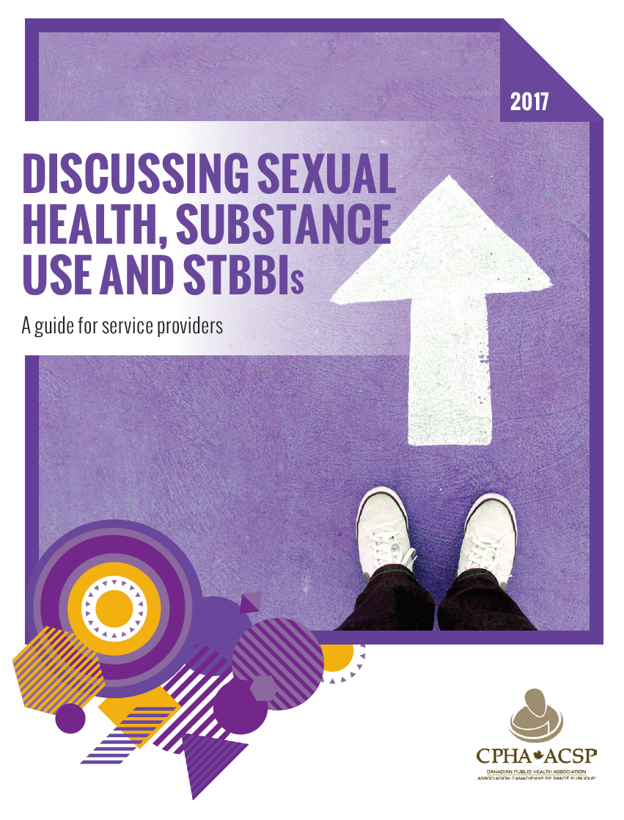
Discussing sexual health, substance use and STBBIs: A guide for service providers
(CPHA, 2017)

Slide 20

Creating a safe environment
Use clear and inclusive language.
Be aware of your body language/ be aware of your own values.
Avoid risk-based language.
Be cognizant of the many layers of stigma.
Be aware of STBBI reporting requirements in your province.
Respect your client's right to privacy and confidentiality, and have a clear conversation about potential limits to confidentiality.
Avoid any assumptions about a client’s sexual orientation, gender identity, sexual practices, substance use, etc.
Ensure you are in a private and comfortable space.
Be cognizant of the many factors that may increase a client's vulnerability to STBBIs.

Slide 21
Practices
Asking about your client’s sexual and substance use practices will help you identify their health and well-being needs. This can lead into talking about testing and harm reduction strategies to reduce STBBI transmission.
I’m going to get more detailed here and ask you about the kind of sex you’ve had as well as your substance use.
Note: Ensure to ask about all types of sex and substances. Use clear and concise language and define terms when necessary.

Slide 22
Partners
Gather some information about your client’s sexual and substance use partners to add to your discussion of strategies to reduce STBBI transmission.
How many different people have you had sex with in the past 2 months? In the past year?
0? 1-2? 3-10? 10+?
Who do you normally use substances with? How do you typically use together?

Slide 23
Protection from STBBIs
Find out what, if any, strategies your client uses to limit STBBI transmission. You will be better able to assess the challenges they face and offer the right support and referrals.
Do you have any concerns about using barriers (e.g., cost, your partners not wanting to use them, don’t know how to use them, etc.)?
Can you share with me what you know about protecting yourself and your partners from STBBIs?

Slide 24
Past history of STBBIs
Finding out about your client’s past STBBI history opens the door to talking about the importance of routine STBBI testing and other STBBIs not included in testing (e.g. herpes, genital warts).
Have you ever been tested for HIV or other STBBIs?
Do you have any signs or symptoms that worry you – any lumps, bumps, discharge, pain?"

Slide 25
Pregnancy
This discussion presents an opportunity to discuss pregnancy options with those who want to become pregnant now or in the future, with those who do not want to become pregnant, and with those who are currently pregnant and want to discuss their options and/or prenatal care.
Are you pregnant now?
Are you or your romantic or sexual partner(s) trying to get pregnant? Are you or your romantic or sexual partner(s) interested in becoming pregnant in the future?

Slide 26
Wrapping-up the discussion
Thank the individual for being open and honest with you. Invite them to ask about any other information or issues that they were not ready to discuss earlier. Before ending your discussion, provide the client with appropriate resources and referrals.

Slide 27

Practice!
Please sit in groups of 2 or 3. You will receive a case example. One person will act as the client, one person the service provider, and one person will observe.
The client will be provided with a script of pertinent information. The service provider will use the discussion guide to assist them in having a conversation with the client. The third individual will act as an observer and will take notes on what worked well.

Slide 28

Discussing sexual health, substance use and STBBIs: Action plan
What are your next steps and action plans?

Slide 29
Thank you for your participation!
Questions or comments?
Please complete the evaluation questionnaire. Your confidential feedback is very important to us.

