Slide 1
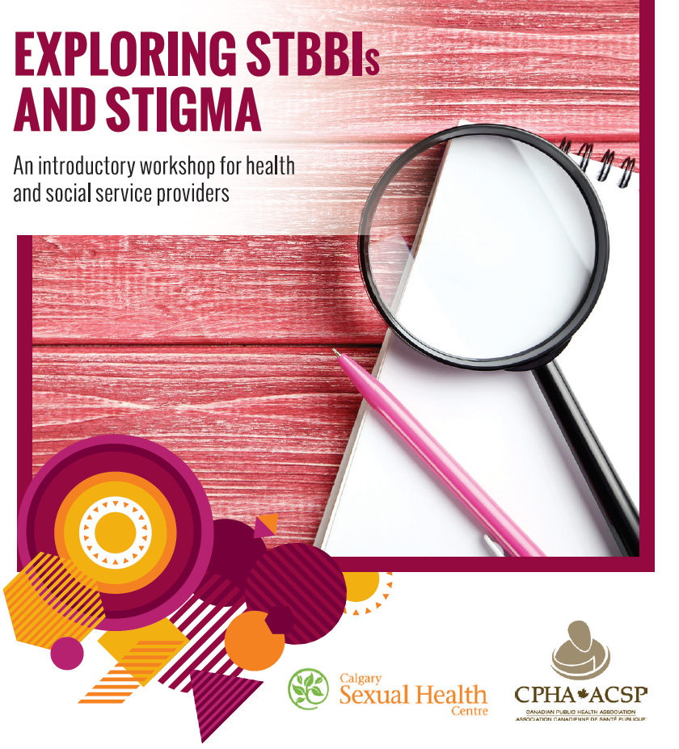



Slide 2


Slide 3

Learning objectives
Increase knowledge of the various forms of stigma and the factors that contribute to STBBI-related stigma, including personal values and beliefs as well as organizational policies and practices.
Increase ability to self-reflect on personal values and beliefs related to STBBIs, sexuality and substance use.
Increase comfort in discussing STBBIs, sexuality and substance use.
Increase knowledge of tools and strategies to create safer and more inclusive services.

Slide 4

Learners' rights
Participate
Pass
Privacy
Respect
Fun!

Slide 5

Key terms
STBBIs
Sex-positivity
Harm reduction
Trauma- and violence-informed care

Slide 6

What is trauma-informed care?
“In trauma-informed services, safety and empowerment for the service user are central, and are embedded in policies, practices, and staff relational approaches. Service providers cultivate safety in every interaction and avoid confrontational approaches. Trauma-informed approaches are similar to harm-reduction-oriented approaches, in that they both focus on safety and engagement.”
Reference: Trauma-informed practice guide, BC Provincial Mental Health and Substance Use Planning Council, 2013, available at
http://bccewh.bc.ca/wp-content/uploads/2012/05/2013_TIP-Guide.pdf

Slide 7

What is trauma-informed care?
“A key aspect of trauma-informed services is to create an environment where service users do not experience further traumatization or re-traumatization (events that reflect earlier experiences of powerlessness and loss of control) and where they can make decisions about their treatment needs at a pace that feels safe to them.”
Reference: Trauma-informed practice guide, BC Provincial Mental Health and Substance Use Planning Council, 2013, available at
http://bccewh.bc.ca/wp-content/uploads/2012/05/2013_TIP-Guide.pdf

Slide 8
What is trauma- and violence-informed care (TVIC)?
TVIC expands on the concept of TIC to acknowledge the broader social and structural conditions that impact people’s health, including institutional policies and practices. Talking about sexuality and substance use within service settings can be difficult; using a TVIC approach helps ensure that the broader structural and social conditions are acknowledged and that organizational policies and practices as well as provider practices do not contribute to re-traumatization.
Example TVIC strategies:
acknowledging the effects of historical and structural conditions;
seeking client input about safe and inclusive strategies;
encouraging client empowerment in relation to treatment options and adoption of harm reduction strategies; and
implementing policies and processes that allow for flexibility and encourage shared decision-making.
Reference: Varcoe CM, Wathen, CN, Ford-Gilboe, M, Smye, V, Browne, A. VEGA briefing note on trauma- and violence-informed care. VEGA Project and PreVAiL Research Network. 2016

Slide 9




What did you do on the weekend?

Slide 10

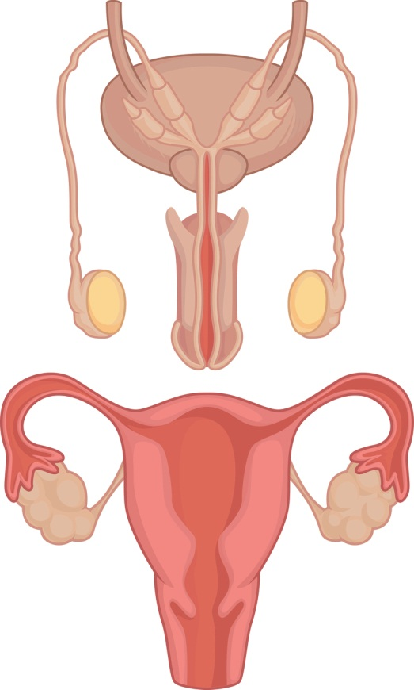


Where did you first learn about sex?

Slide 11

Stigma
What is it?
Where do we see it?
What is the impact?

Slide 12

Stigma defined
Perceived stigma: an individual's awareness of negative societal attitudes, fear of discrimination and feelings of shame.
Internalized stigma: an individual’s acceptance of negative beliefs, views and feelings towards the stigmatized group they belong to and oneself.
Enacted stigma: encompasses overt acts of discrimination, such as exclusion or acts of physical or emotional abuse; acts may be within or beyond the purview of the law and may be attributable to an individual’s real or perceived identity or membership to a stigmatized group.
Layered or compounded stigma: a person holding more than one stigmatized identity (e.g., HIV positive serostatus, sexual orientation, ethnicity).
Institutional or structural stigma: stigmatisation of a group of people through the implementation of policy and procedures.
Adapted from:
Stangl A, Brady L, Fritz K. Measuring HIV stigma and discrimination: STRIVE Technical Brief. STRIVE, July 2012.
Loutfy MR, Logie CH, Zhang Y, Blitz SL, Margolese SL, Tharao WE, et al. Gender and ethnicity differences in HIV-related stigma experienced by people living with HIV in Ontario, Canada. PLoS ONE 2012;7(12):e48168.
Corrigan PW, Markowitz, FE, Watson AC. Structural levels of mental illness stigma and discrimination. Schizophrenia Bulletin 2004;30(3): 481-491.

Slide 14
What do clients think?
Research has shown that professionals should not worry about asking their clients about sexual health. Clients in many settings and across age groups expect their service providers to ask questions about their sexual health (Sargant, Smallwood and Finlay, 2014).
While less is known about clients’ expectations around talking about substance use, the positive outcomes associated with screening for substance use are well documented, so long as discussions are respectful and non-judgmental (Registered Nurses Association, 2015).

Slide 15

What can you do?
1. Clarify your values
2. Use correct terminology
3. Use inclusive language
4. Be aware of your body language
5. Be cognizant of the many layers of stigma
6. Practice answering tough questions
7. Consider your professional obligations
8. Create and maintain inclusive and affirming spaces

Slide 16

Importance of privacy and confidentiality
Respect your client's right to privacy and confidentiality.
Ensure clients understand potential limits to confidentiality.
Ensure you are in a private and comfortable space.

Slide 17

Activity
Values clarification

Slide 18
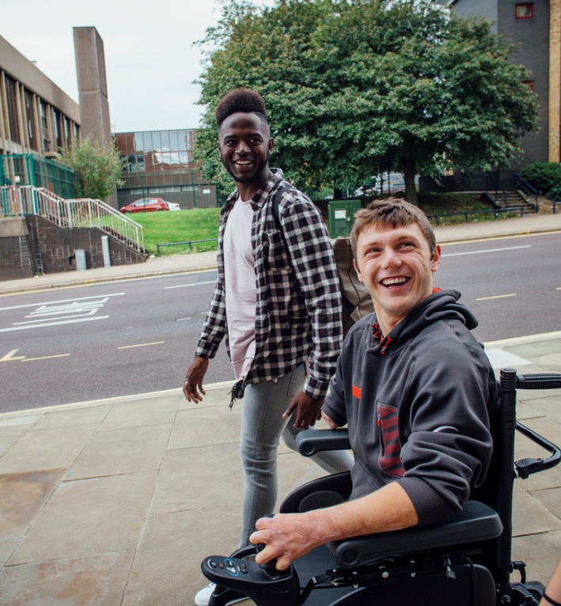
Assumptions
What are some common assumptions or beliefs we may have about individuals accessing our services?
How might these assumptions or beliefs impact our engagement with clients?
What is the impact of these beliefs on service delivery?

Slide 19
Assumptions to avoid
All people are heterosexual/cisgender.
All people are embarrassed to talk about their sexuality or substance use.
All people are sexually active or not sexually active.
All sexual activity is consensual.
All people have the same worldview about sexuality and substance use.
All people have the same level of knowledge about sexuality and substance use.

Slide 20

What are some difficult questions that you have been asked? Or scenarios that you have dealt with?
Why do people ask questions?

Slide 21
Four-step practice tool
Responding to difficult scenarios or questions
1. Check-in
2. Affirm
3. Clarify
4. Answer

Slide 22
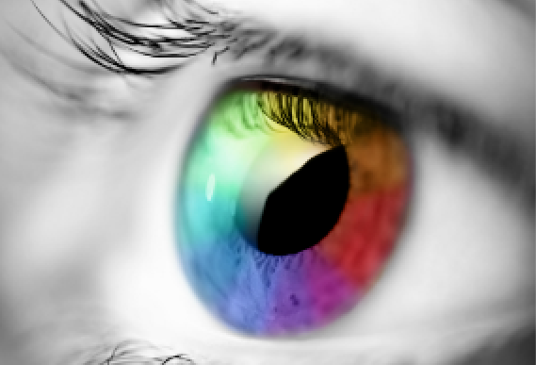
1. Check-in
What are your initial reactions to the question or situation?
What are your beliefs and/or values about this situation or question?
Is your initial reaction related to unconsciously learned beliefs or values (e.g., about certain groups of people, about certain sexual or substance use behaviours)?
What is your body language communicating?
What are your professional responsibilities to the client?

Slide 23

2. Affirm
Let the person know that you are glad that they came to talk to you.
Let them know that their question/scenario is normal.
Normalize any thoughts/concerns that they may have about their question/the scenario.

Slide 24

3. Clarify
Ask the individual what they need (e.g., what they already know, what they would like to know, if they would like access to specific services).
Ensure that you understand the scenario or question correctly.
Clarify the language they are using and be sure to use inclusive language in your discussion.

Slide 25

4. Answer
Provide the facts.
Be aware of your values and ensure that they are not present in your answer.
Check-in with the individual to see if they have further questions or need more information/access to specialized services.
Provide a meaningful and safe referral, if necessary.
Be aware of nonverbal body language.

Slide 26

Practice!

Slide 27

What can we do?
How do we create safer and more inclusive spaces?

Slide 28

See
What are some indicators within your workplace that would signify that it is an inclusive space for all people?
What are some indicators that would signify barriers for service, or that might make people feel unsafe?
What changes could be made?

Slide 29
"Even when I go into a doctor’s office, I look around the waiting room to see if there is anything Aboriginal in there—even a blade of sweet grass. Some sign that the health care provider is aware of Aboriginal culture."
"I want to go to a place where the people reflect who you are. Like gay, lesbian and bisexual service providers."
Canadian Public Health Association, 2012 (focus group participants)

Slide 30

Hear
What do people hear within a safe space?
Is the language used within your workplace inclusive and respectful?
Is there space for private conversations?
What changes could be made?

Slide 31
"Doctors don’t always explain the tests they are doing—this makes us uncomfortable."
"My family doctor knows how to open up discussion just by asking “How was your day?"
"I like to be talked to with empathy, as if I’m someone that they care about and want to help. Talking in a very clinical way leaves out the social and emotional parts of having HIV or an STI."
Canadian Public Health Association, 2012 (focus group participants)

Slide 32

Feel
Are services provided in a way that is considerate of the impacts of stigma?
Are the unique experiences of individuals honored and recognized?
How do people feel within your service setting?
How do you know how your clients are feeling?
What changes could be made?

Slide 33
"Discrimination is systemic against African, Caribbean and Black people, even in blood donation. There are lots of pre-existing stereotypes about Black people, which may make people reluctant to get tested. They feel pre-judged."
"People don’t want to go into a health office because they feel they are going to be judged and discriminated against. Don’t want to get tested because they are scared. When I go to the [clinic] to get tested, I feel like people imagine all sorts of weird circumstances about me."
Canadian Public Health Association, 2012 (focus group participants)

Slide 34
What can we do?
How do we create safer and more inclusive spaces?

Slide 35
Questions to consider
What changes can be made to make services more inclusive and accessible?
What would you need to advocate for within your organizations in order to make these changes?
What support would you need within your organization in order to make these changes?
Who within your organization needs to be engaged in order to see these changes realized?

Slide 36
Organizational assessment tool for STBBIs and stigma (CPHA, 2017)
The purpose of the Organizational assessment tool for STBBIs and stigma is to help health and social service organizations create settings where all service users feel welcomed and supported in seeking care, and where staff and volunteers are supported in providing care in a safe and respectful environment.
The tool identifies the policy, environmental and cultural factors that contribute to stigma and discrimination, and which can affect individuals’ access to and use of available services.

Slide 37

Thank you for your participation!
Questions or comments?
Please complete the evaluation questionnaire. Your confidential feedback is very important to us.

