Slide 1
Using this Template
This template can be used to guide the facilitation of the Orientation Meeting in your organizational assessment process
Slides and speaking notes can be edited as desired
The orange highlighting shows areas where you can include details specific to your organization and assessment process
You are welcome to apply your own slide templates or branding

Slide 2

Organizational Stigma Assessment Tool:
Orientation Meeting
Date
Your organization's logo
Notes:
Notes:
Welcome participants and open the meeting as you would customarily (e.g., land acknowledgements, introductions as needed)

Slide 3
Land Acknowledgement
Insert your land acknowledgement if this is customary for your organization
Notes:
Notes:
Welcome participants and open the meeting as you would customarily (e.g., land acknowledgements, introductions as needed)
- It may be helpful to contextualize your land acknowledgement based on the topic/organizational assessment (e.g., highlighting that some populations disproportionately bear the burden of stigma, including Indigenous populations; engaging in an intentional process of assessment around stigma and your organization can lead to better services and health outcomes for populations you serve, including Indigenous communities, etc.)

Slide 4

Introductions
Name
Pronouns (optional)
Role in relation to [name of organization]
What you hope to gain from this process
Fun fact
Notes:
Notes:
- Depending on who is involved and their existing relationships, you may wish to include a roundtable of introductions

Slide 5
Agenda
Intended outcomes
Background: STBBI stigma in organizations
The Organizational Stigma Assessment Tool
Completing the assessment
Next steps/action planning
Questions

Slide 6

Intended Outcomes
Outcome 1
Outcome 2
Outcome 3
(see example outcomes in speaking notes)
Notes:
Notes:
- Include your intended outcomes for the assessment process. Potential outcomes could be to:
Identify the policy, environmental and cultural factors that contribute to stigma and discrimination and affect individuals’ experience with [name or organization]
Foster open discussion and sharing perspectives from different points of view within the organization
Identify priority goals for action (short-, medium- and long- term)
Align with ongoing related initiatives (e.g., work on anti-racism, Truth & Reconciliation, etc.)

Slide 7
STBBI Stigma
People may experience stigma because:
They have HIV, Hepatitis C, or an STI;
They are a part of a community that experiences disproportionate rates of these sexually transmitted and blood borne infections (STBBIs)
Stigma is a major barrier to individuals accessing STBBI testing, treatment and prevention services.
Stigma and discrimination related to STBBI status and intersecting identities have significant impacts on access to health and social services and overall wellness
Notes:
**The level of detail you choose to provide in slides 7-10 will depend on the level of knowledge and awareness that your Assessment Participants have regarding STBBIs, stigma and intersecting issues. You may choose to bring in additional information/examples based on the services your organizations provides and the communities served.
Notes:
Stigma that people experience, because they have HIV, Hepatitis C or an STI, or because they are part of a population group that experiences disproportionate rates of these STBBIs is a major barrier to STBBI testing, treatment and prevention services. Consider how assumptions are made about individuals based on populations they belong to that are disproportionately impacted by STBBIs.
On top of this, stigma and discrimination related to STBBI-status, and intersecting identities such as race, culture, gender identity, sexual orientation, disability and immigration status, have significant impacts on how people access and experience sexual health and substance use-related services. Stigma also impacts other facets of social, family and community life and a person’s general well-being.
Consider, for example:
Feelings of fear and shame can discourage people from getting tested or disclosing their status
Assumptions made about a person can result in them not receiving the care/services they may need
Experiences of stigmatizing language, behaviours or policies when accessing care can erode trust and discourage future engagement in care

Slide 8
Lived Experiences of Stigma
Quotes from focus groups conducted by CPHA in 2022
"We're not just what we were diagnosed with, what we were born or our race, what have you. We are people first before we are these things.”
“All sorts of language towards people who use drugs. Assumption of folks to be dirty, irresponsible, dangerous, etc.”
"And then the nurse…came in to where I was laying on the bed and he said, ‘If you're looking for narcotics, you're not going to get it. So you might as well just go home.’”
“ [A] word itself can feel like an attack on our character, whereas like if someone just changed the word it doesn’t feel like it.”
“And on the form, checking the HIV box, I learned never to be honest again. Every single person that would get my file, they'd be trying to pass it off to somebody else. Every single one of them had a hangnail and had to wear gloves. It got ridiculous."
Notes:
**These quotes were shared in focus groups with CPHA in 2022. Feel free to adjust this slides to replace them with quotes from your organization’s own consultations/reports.
Notes:
The quotes on screen show a more personal side to this and demonstrate some of the ways that people have experienced stigma related to having HIV or an STI and also these intersecting identity factors, and how people do not always feel welcome bringing their whole selves when accessing sexual health and substance use related care

Slide 9
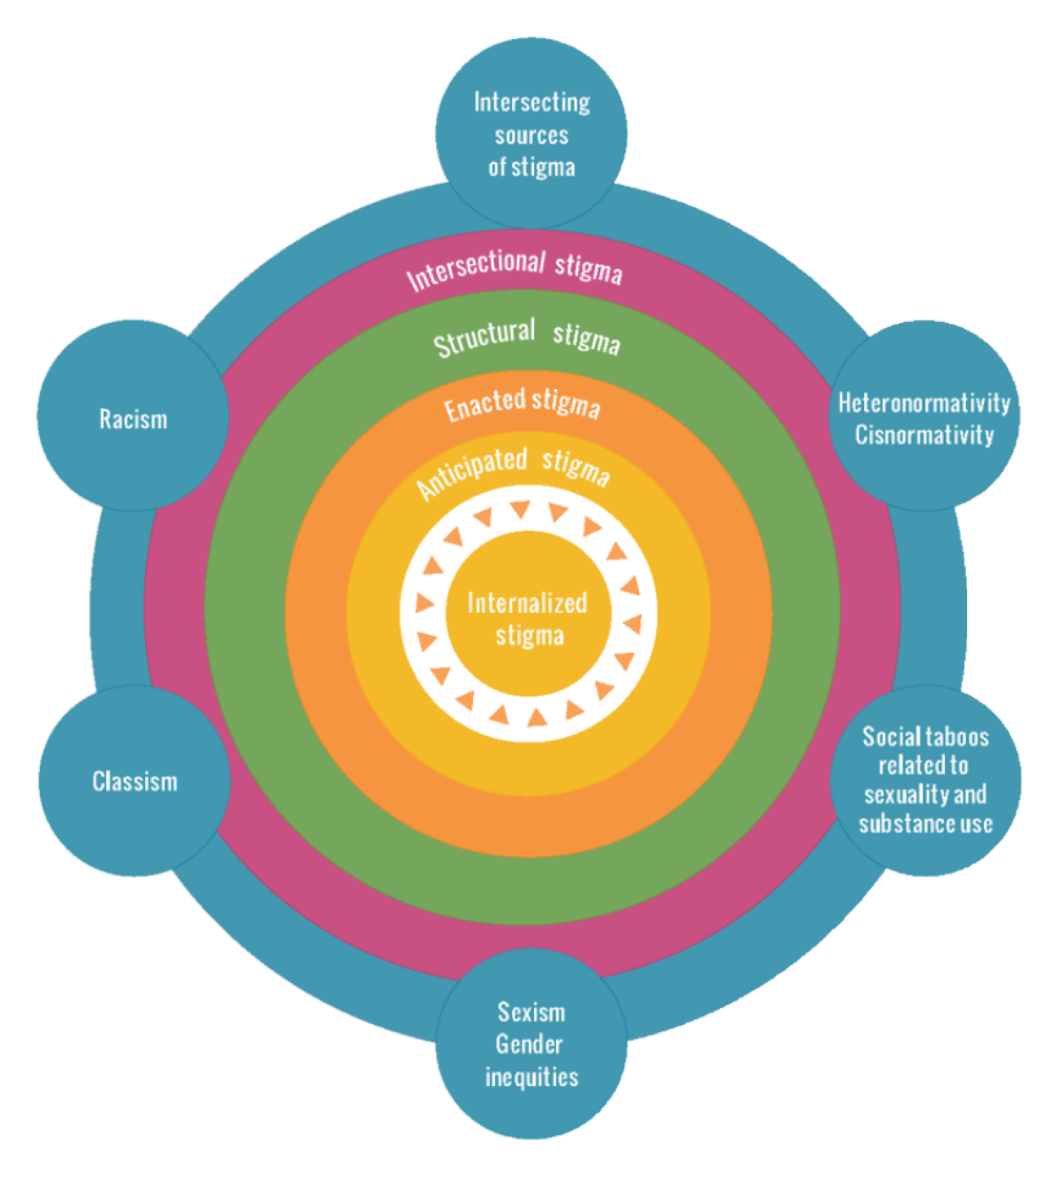
Stigma within Organizations
Internalized stigma: An individual’s acceptance of negative beliefs, views and feelings toward the stigmatized group they belong to and themselves.
Perceived/anticipated stigma: Awareness of negative social attitudes, fear of discrimination and feelings of shame.
Enacted stigma: Acts of discrimination, such as exclusion, or physical or emotional abuse.
Structural stigma: Polices, practices, programs and laws that perpetuate inequities and discrimination towards a group of people.
Intersectional stigma: The joint effects of an individual or group holding multiple stigmatized identities.
Notes:
Notes:
We can think about stigma as operating, often simultaneously, on many different levels. Ways that stigma is embedded at the level of organizations (structural stigma), or even broader such as through laws and social norms, can trickle down to impact how individuals within this system think and behave (enacted stigma), and also how people who belong to stigmatized groups feel about themselves (internalized stigma) and expect to be treated (perceived/anticipated stigma).
Because of the ways that stigma at the organizational level can impact the behaviours, attitudes and experiences of those working within and accessing services at the organization, it’s important to think about how to intervene here (at the structural/organizational level)
Forms of stigma:
Perceived/Anticipated stigma: Awareness of negative social attitudes, fear of discrimination and feelings of shame.
Internalized stigma: An individual’s acceptance of negative beliefs, views and feelings toward the stigmatized group they belong to and themselves.
Enacted stigma: Acts of discrimination, such as exclusion, or physical or emotional abuse.
Structural stigma: Polices, practices, programs and laws that perpetuate inequities and discrimination towards a group of people.
Intersectional stigma: The joint effects of an individual or group holding multiple stigmatized identities.

Slide 10
Stigma within Organizations
Stigma is ingrained in policies, practices and within larger social and economic systems.
Organizations operating in these systems can moderate or influence how people experience stigma.
Stigma and discrimination within health and social service settings:
complicate public health efforts;
act as barriers to individuals seeking support, services or care;
perpetuate health inequities.
Notes:
Notes:
Stigma exists in all the systems that we work in, it's the water we swim in. Despite good intentions of those working within health and social service organizations, people are likely to anticipate and experience stigma when accessing sexual health, substance use and STBBI-related services because of the ways these topics and experiences are stigmatized in our wider society.
When thinking about stigma within organizations it's also important to think about how those working or volunteering with organizations can experience stigma first-hand based on their own stigmatized experiences and identities.
Those of us who are working in these health and social service systems also have an opportunity (even, responsibility) to drive change for the better.
We know that stigma and discrimination within health and social service settings has serious impacts for people and communities:
complicating public health efforts (e.g., people might be ashamed to learn or disclose their status, to get treated)
creating barriers to care and prevention services
perpetuating health inequities (such as those already experienced by 2SLGBTQ+ populations, Indigenous peoples, ACB communities, newcomers, people with disabilities)
The goal of the Organizational Assessment Tool is not to place blame on individuals/organizations but to acknowledge where stigma exists and provide an opportunity for discussion about ways to address it by sharing different perspectives from within the organization.

Slide 11
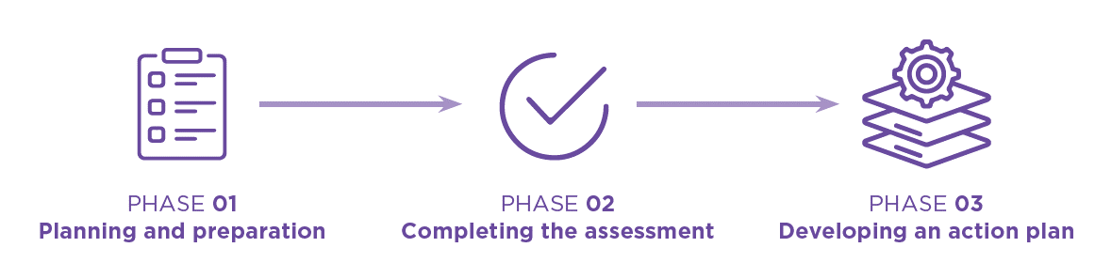
Overview of Process
This Orientation Meeting is part of Phase 1
This meeting will go over the process of completing the Tool
Over the next [timeframe] Assessment Participants will individually complete the Tool
[Date]: we will meet again for a Debrief Meeting including Assessment Participants and the Working Group
After the Debrief Meeting, [describe next steps for action planning including who will be involved and how the Assessment Participants will be kept informed of progress/next steps]
Notes:
Notes:
Planning and preparation: this includes today’s meeting to kick off the process and share key information with all participants
Completing the assessment: Assessment Participants will be asked to complete the Tool individually. This phase will end with a Debrief Meeting to discuss responses. Clarify if participants will be asked to complete the Tool during this meeting, on their own time, or at the start of the Debrief Meeting.
Developing an Action Plan: a set of priority action items will be developed based on the group discussion and ratings

Slide 12
Overview of Roles
Working Group
Staff and stakeholders (e.g., community members, advisory group members) who are responsible for coordinating the assessment process
[Specify who this includes and who the main point of contact is]
Assessment Participants
Everyone at this meeting, who will be asked to complete the Tool
[Specify who (i.e., which roles/areas of the organization) is included]
Notes:
Notes:
Working Group:
Those tasked with coordinating the assessment process, including making some key decisions about the process, and organizing meetings.
Identify who this includes for your organization (e.g., staff, leadership representatives, volunteers, board members, advisory committee representatives).
Clarify the role of the Working Group in developing and implementing the Action Plan.
Assessment Participants:
Assessment Participants are those who are asked to complete the Tool (or specific sections) and participate in the Orientation and Debrief Meetings.
Identify who this includes for your organization (e.g., staff in which roles and from which parts of the organization, leadership representatives, volunteers, board members, advisory committee members, service users, community partner representatives, etc.)
Clarify the role of the Assessment Participants in developing and implementing the Action Plan.

Slide 13

Organizational Assessment Tool
This Tool aims to help organizations identify and reduce stigma for individuals and communities accessing STBBI-related services
The Tool guides reflection across five major areas:
Policies and procedures
People and culture
Organizational spaces
Programs and services
Ongoing evaluation, improvement, and accountability
Notes:
Notes:
The Tool was developed by the Canadian Public Health Association in partnership with Centre for Sexuality based on consultation and partnership with many organizations and individuals bringing diverse insights from both lived and professional experience.
The Tool aims to help organizations identify and reduce stigma for individuals and communities accessing STBBI-related services.
Guides reflection across five major areas:
Policies and procedures
People and culture
Organizational spaces
Programs and services
Ongoing evaluation, improvement, and accountability

Slide 14
Completing the Assessment
Everyone will be asked to complete the assessment individually
Using the Tool, you will provide a rating for each indicator
There is space available to add notes and expand on your rating
Share the specifics around if/how individuals' responses will be collected and compiled
At a Debrief Meeting, [facilitators] will facilitate discussion on your reflections from completing the Tool (including opportunities to share anonymously through polls, annotation)
Debrief Meeting: [date]
Please complete the assessment before this meeting
Notes:
Notes:
Provide Assessment Participants with details of how your organization will complete the assessment process including:
The process that the organization will use to collect individuals’ responses (e.g., pen and paper, online survey, polls/discussion during the Debrief Meeting)
An estimate of how long it will take to complete the Tool (1 hour) and when participants will complete it
How the results will be discussed/debriefed (i.e., who is leading the conversation, how will decisions be made/consensus be reached)
An estimate of the overall timeline for completing the action plan

Slide 15

Sections of the Tool
You will be asked to complete [the whole Tool/select sections]
You may feel that some parts of the Tool apply more to your work. The Debrief Meeting may focus on some sections more than others.
Notes:
Notes:
This Tool aims to help organizations identify and reduce stigma for individuals and communities accessing STBBI-related services. In doing so, the Tool guides participants to reflect across five major areas of the organization:
Policies and procedures that can support a safer, more inclusive environment
People and culture, which touches on issues around human resources, partnerships and the broader organizational culture
Organizational spaces, which includes thinking about both the physical and digital spaces where your work takes place
Programs and services, which focuses on incorporating stigma awareness in how programs and services are delivered
Ongoing evaluation, improvement, and accountability, which touches on how we collect, use and hold ourselves accountable to feedback to improve how the organization serves the community and others who interact with us

Slide 16
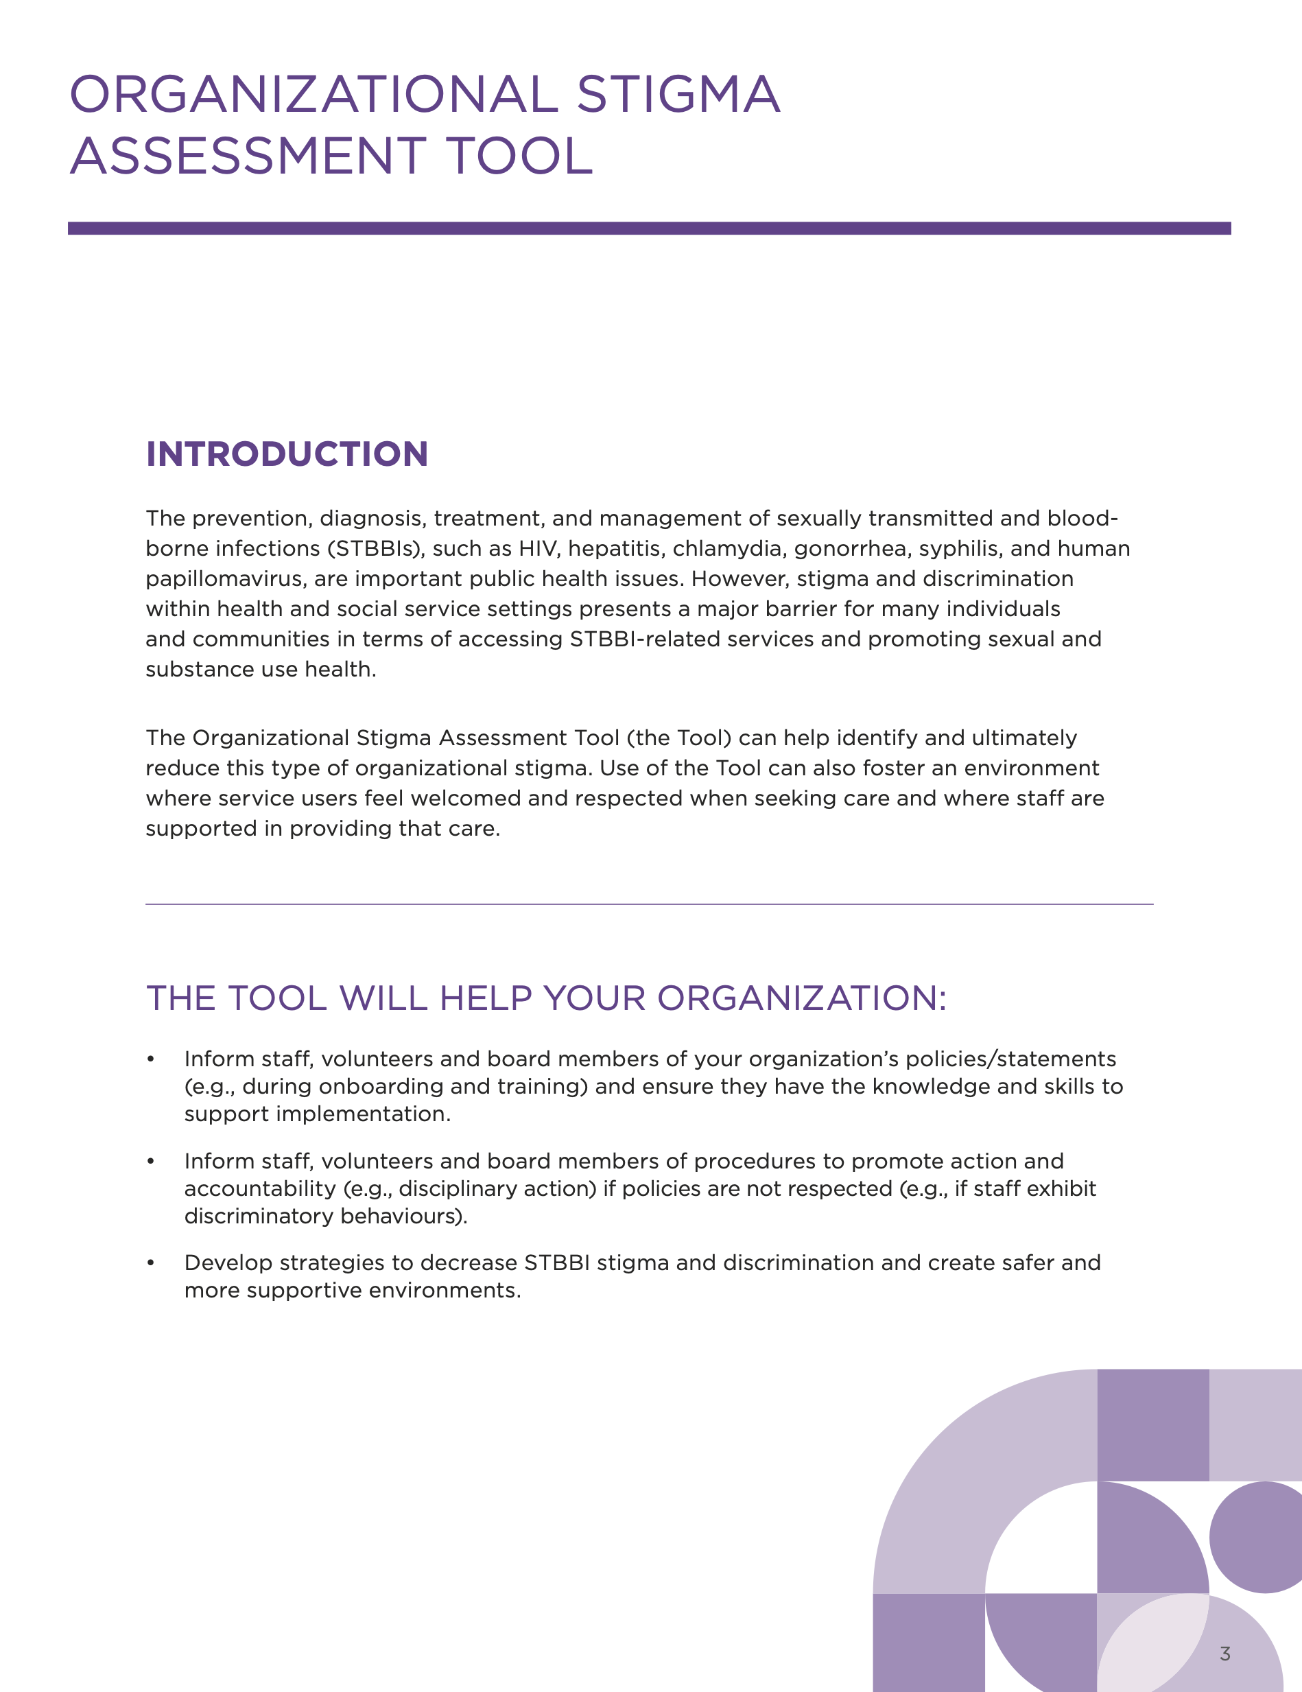
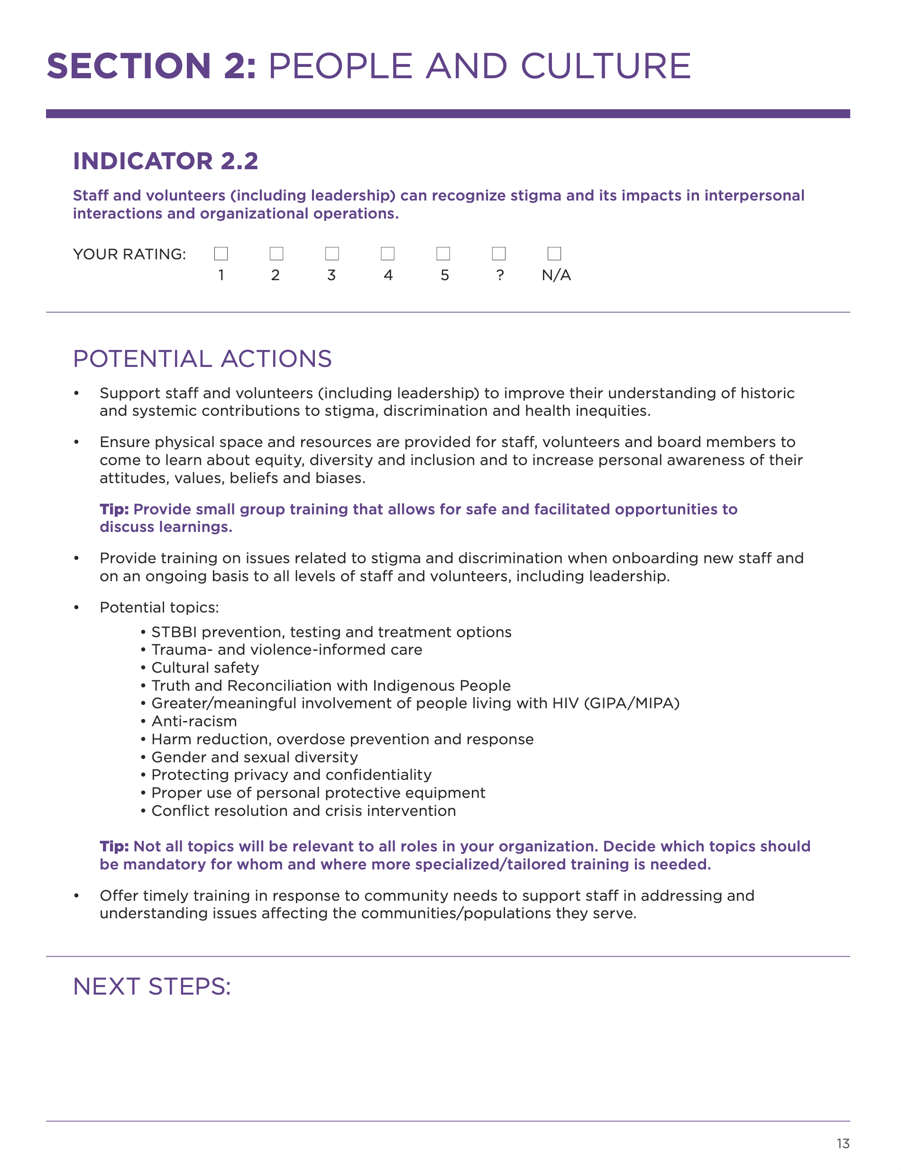

Inside the Tool
Notes:
Notes:
This slide shows an example of one of the indicators in the Tool.
You will see the indicator written at the top, with a space for you to add your rating for this indicator.
Below, you'll notice a list of potential actions. These are examples of ways that this indicator might be addressed to help you understand what this indicator might look like in practice. These can help you to assign a rating, or to consider potential areas for actions or improvement.
Finally, there is a space to add any notes or expand on the rating you provided.

Slide 17
Rating Scale
1 = No Recognition | We have not been aware of the indicator and no specific steps or discussion have taken place.
2 = Recognition | We have not yet addressed this indicator directly but have acknowledged it.
3 = Partial Integration | We have recognized this indicator and are starting to work on it (planning, discussion phases).
4 = Substantial Integration | We are actively addressing this indicator and establishing processes.
5 = Complete Integration | We have addressed this indicator and processes are in place.
? = Unsure | We are not aware of our organization’s stance, readiness, or practices in relation to the indicator (clarification may be needed).
N/A = Not Applicable | The indicator is not relevant to our organization, context, community and/or scope of services.
Notes:
Notes:
Assessment Participants will assign a rating to each indicator using this scale
Note here that there is no specific "right" answer to any indicator, and that each should be rated based on individual perception.
There are options to choose 'Unsure' or 'Not applicable' if participants are not aware of how this indicator might be implemented in your organization, or if it is not applicable.

Slide 18
Creating a Safer Space for Sharing
Assessment Participants include a selection of staff and leadership [name others, like service users/volunteers if applicable]
Setting the tone for open conversation during the Debrief Meeting
These discussions may feel challenging or uncomfortable but should not feel unsafe
Importance of group rights/responsibilities
Protecting privacy
Notes:
Notes:
Acknowledge that these discussions can bring up challenging or uncomfortable feelings, whether these are personal in nature (e.g., lived experiences of stigma) or critical and vulnerable reflections on your organization and its culture.
Sometimes discomfort is necessary for learning and growth, but we want to ensure that everyone feels safe and supported to participate in these discussions.
The ability to safely surface these reflections is a necessary opportunity for learning and a key element of a successful assessment process. For this to happen all participants need to feel safe and supported throughout their participation in the assessment.
Group rights/responsibilities will be co-created at the beginning of the Debrief Meeting.
Highlight the specific ways that privacy will be protected:
Participants will be encouraged to share as much or as little as they are comfortable with;
Some opportunities will be provided to engage anonymously (i.e. using polls, annotation) during the Debrief Meeting;
Responses to the Tool will only be shared in aggregate form (averages) and no quotes from respondents will be shared that might identify the person.

Slide 19
Creating a Safer Space for Sharing - The Role of Leadership
Name senior leadership representatives that will be present for Debrief Meeting and describe the role they will have during the meeting. E.g., [Name's] focus will be to observe and listen, and answer questions as needed
Leadership will play a key role in identifying action items after the Debrief Meeting in collaboration with [others who will be involved in action planning] and will share this back with the Assessment Participants for discussion
Notes:
**You will need to consider the power dynamics that might exist within your group or organization that may challenge unhindered participation in the assessment process and how you want to position this during the Orientation Meeting. This will likely depend on who will be participating and the roles they hold in the organization (e.g., program staff participating alongside managers, service users participating alongside service providers).
Notes:
It is integral to have decision makers from our organization involved in the process, while also ensuring that staff have opportunities to contribute and direct the assessment process.
Describe how those holding positions of power over others will be included and any measures taken to help manage these power dynamics
Examples of ways to mitigate these dynamics include:
Ensuring the Working Group includes members from different areas/levels of the organization
Limiting leadership participation in the Debrief Meeting or providing a summary of the discussion rather than having them attend.
Having more than one Debrief Meeting with different groups of participants
Provide opportunities to share outside of meeting or provide feedback to the Working Group through anonymous or confidential channels

Slide 20
Moving Results into Action
In the Debrief Meeting, indicators will be prioritized based on the Assessment Participants' collective ratings and group discussion
[Describe how an Action Plan will be developed. E.g., Working Group will propose a set of action items based on the group discussion and ratings]
These action items may include short-, medium-, and long-term goals
[Any ongoing initiatives that actions will be intended to align with]
[Describe next steps for Assessment Participants: E.g., these action items will be shared back with the Assessment Participants for review, discussion, and identifying next steps]
Notes:
Notes:
Inform participants about how the discussions taking place in the Debrief Meeting will be moved into action. This might include:
Introducing the Action Plan Template
Who will work on the Action Plan (e.g., Working Group, Assessment Participants, and/or other staff, volunteers, service users/community members, board members etc.)
When and how it will be developed
How it will be actioned and sustained over time
Plans to involve and/or share the assessment findings with others
Set clear expectations for completing the assessment, participating in the Debrief Meeting, and informing the Action Plan.

Slide 21

Remember...
Stigma can be found in nearly every aspect of an organization and takes time to meaningfully address
Small, incremental changes can have a big impact over time!
Notes:
Notes:
Remind participants that stigma has impacts at all areas/levels of the organization
The process might involve consideration of changes in human resources, operations, program/service delivery, partnerships etc.
Highlight that this is not a short-term process – it is a marathon not a sprint
Let them know of plans/opportunities to revisit this work (e.g., annually)
Lots of changes might be identified but they will not all be immediate priorities – part of the process will be to set priorities and consider them against the resources and time available. No organization is expected to score 'perfectly'.

Slide 22
Summary
Complete assessment by [date]
Debrief Meeting on [date] will be to discuss the groups responses
Email [name] with any questions at [email]
Notes:
Notes:
Let participants know when there is time allotted for them to complete the Tool (e.g., right after this presentation, over the next week, at the start of the Debrief Meeting)
State the deadline of when participants need to complete the Tool individually (and submit, if applicable) and advise participants of who to reach if they have questions.

Slide 23
Thank you! ________________ Questions?

