Slide 1
Using this Template
This template can be used to guide the facilitation of the Debrief Meeting in your organizational assessment process
Slides and speaking notes can be edited as desired
The orange highlighting shows areas where you can include details specific to your organization and assessment process
You are welcome to apply your own slide templates or branding

Slide 2

Organizational Stigma Assessment Tool:
Debrief Meeting
Date
Your organization's logo
Notes:
Notes:
Welcome participants and open the meeting as you would customarily (e.g., land acknowledgements, introductions as needed)

Slide 3
Land Acknowledgement
Insert your land acknowledgement if this is customary for your organization
Notes:
Notes:
Welcome participants and open the meeting as you would customarily (e.g., land acknowledgements, introductions as needed)
- It may be helpful to contextualize your land acknowledgement based on the topic/organizational assessment (e.g., highlighting that some populations disproportionately bear the burden of stigma, including Indigenous populations; engaging in an intentional process of assessment around stigma and your organization can lead to better services and health outcomes for populations you serve, including Indigenous communities, etc.)

Slide 4

Introductions
Introductions from facilitators and/or Assessment Participants (optional)
Notes:
Notes:
If you choose to do introductions, you may include:
- Name
- Pronouns (optional)
- Role in relation to [name of organization]

Slide 5

Intended Outcomes
Outcome 1
Outcome 2
Outcome 3
(see example outcomes in speaking notes)
Notes:
Notes:
- Include your intended outcomes for the Debrief Meeting. Potential outcomes could be to:
Identify strengths and areas of opportunity to reduce stigma and better support staff and service users
Promote reflection and discussion amongst staff to build on existing work
Discuss potential action areas (short-, medium-, long-term)

Slide 6
Aligning with Other Initiatives
Add points as needed to speak to ongoing initiatives/areas of work at your organization that align with the objectives of the STBBI Organizational Stigma Assessment Tool [e.g., Truth & Reconciliation, anti-racism, EDI, accreditation]
Notes:
-**For example, you may wish to highlight relevant objectives and commitments in your organization’s strategic plan, speak to how discuss how today’s discussion will help inform ongoing work in other areas such as anti-racism work, efforts to integrate trauma informed practice, ongoing quality improvement efforts, etc.

Slide 7
Rights and Responsibilities
Participate
Pass
Privacy
Respect
Fun
Notes:
Notes:
Speak to the importance of creating an environment where people feel safe to share and can participate in the ways that feel most comfortable to them. To help support this, start by coming to a consensus about the rights and responsibilities everyone has when participating in this process. Speak through each of the following points:
Participate
Go over the various ways that everyone will be able to participate during the meeting today. The specifics will depend on how you are holding the session (e.g., whether you are holding the meeting online or in person, and what facilitation tools you wish to use) but might include:
Asking questions
Sharing their thoughts/opinions verbally or using the chat box
Responding to polls anonymously
Annotating on screen anonymously
Raising their hands to indicate their ratings or agreement
Active listening
Note that it is also important to be mindful of others’ rights to participate and ensure that you leave space for others to contribute.
You may find it helpful to ask the group if they perceive of any barriers to their participation in the Debrief Meeting. You can then proactively address those barriers with the group before proceeding.
Pass
There may be times where you do not want to or feel comfortable participating in certain discussions. You can choose how much you wish to share and when, which is your right to pass.
If you find that you need to step away for certain parts of the discussion to take care of yourself emotionally or physically you are welcome to do so.
Inform participants if members from the Working Group will be available for one-on-one follow-up conversations about the assessment process.
Privacy
The intention of this exercise and the environment we are creating together is to allow for honest sharing.
Encourage participants to keep the discussions that will take place during the meeting private and to take care to ensure that any examples or stories they choose to share do not identify other members of the organization (e.g., staff or others).
Empower participants to be mindful of their own boundaries around what feels comfortable to share, Remind them if members of the Working Group will be available for further discussions.
Respect
While we are all respectful people and expect that everyone is coming to these conversations with the best of intentions, it’s important to think about what it might look and feel like to demonstrate respect with each other.
Remind participants that we all come with diverse personal experiences related to stigma, sexuality, substance use, etc. within your organization.
Normalize that engaging in an assessment of your organization will bring up feedback that can be interpreted as critical.
Ask assessment participants: What do we need from each other in order to ensure that this feels like a respectful space?
Participants may bring up a range of different ideas. Some common examples include listening and responding with curiosity and not judgement, humility and open-mindedness, attentiveness, not talking over one another, avoiding making generalizations or assumptions, seeking common ground, being mindful of language, respecting others’ pronouns, and acknowledging mistakes and taking accountability
Fun
A greater awareness of stigma and increased efforts to build a supportive and inclusive environment builds the foundation for more positive and fun interactions between different members of the organization.
The hope is that working collaboratively as a team and identifying common goals will be a fun and positive experience in and of itself as well!
Invite participants to add to the group rights and responsibilities. Ask participants to agree to the rights and responsibilities for the Debrief Meeting.

Slide 8
Tools for Interaction
We will be using various interactive features to help support discussion on each of the five sections of the tool:
Add options for participation (see Notes for examples)
Notes:
Notes:
Examples (Online)
Show of Hands
Chat box
Anonymous Polls
Annotation
Examples (In-Person)
Show of Hands
Polls
Chart Paper/Sticky Notes

Slide 9
Rating Scale
1 = No Recognition | We have not been aware of the indicator and no specific steps or discussion have taken place.
2 = Recognition | We have not yet addressed this indicator directly but have acknowledged it.
3 = Partial Integration | We have recognized this indicator and are starting to work on it (planning, discussion phases).
4 = Substantial Integration | We are actively addressing this indicator and establishing processes.
5 = Complete Integration | We have addressed this indicator and processes are in place.
? = Unsure | We are not aware of our organization’s stance, readiness, or practices in relation to the indicator (clarification may be needed).
N/A = Not Applicable | The indicator is not relevant to our organization, context, community and/or scope of services.
Notes:
-**You may find it helpful to review the rating scale with participants prior to discussing their responses. Assessment Participants will have assigned a rating to each indicator using this scale.
Notes:
Were there any questions or confusion about the scale and rating the indictors? Overall, did you have a hard time or easy time coming up with ratings for the indicators?
Note here that there is no specific "right" answer to any indicator, and that each should be rated based on individual perception.
There may be parts of the organization that work on these areas that you might not see or be aware of, or that pertain more to other areas of the organization. For these you might select '?' If you're unsure, or N/A if it's not applicable to our work.
Recommend having the Tool open so that you can refer to the potential actions during our discussions today.

Slide 10
Overall Impressions
Invite participants to share their overall thoughts or impressions on completing the Tool.
If you have collected responses ahead of the meeting, you might present an overview of findings here (example below).
Section​ | Average rating/score​
1. Policies & Procedures​ | 0
2. People & Culture​ | 0
3. Organizational Spaces​ | 0
4. Programs & Services​ | 0
5. Ongoing Evaluation, Improvement & Accountability​ | 0
Notes:
Notes:
Invite participants to share their overall impressions of the assessment process.
If responses were collected ahead of the meeting, you might include an overview of the findings here
Discuss how you have protected participants' privacy when compiling group responses
Clarify how the rest of the discussion will be structured (e.g., going through each section or indicator, asking participants to share ratings, identifying priorities for action)

Slide 11
Policies & Procedures
3.4
1.1 Your organization has formal policies and related documents (e.g., core values statement, organizational declaration) to ensure a safer, inclusive and equitable environment for all staff, volunteers, board members and service users.
1.2 Your organization has formal protocols and/or mechanisms to ensure ongoing implementation of existing policies for safe, inclusive and equitable environments for all staff, volunteers, board members and service users.
1.3 Your organization reviews its policies and protocols regularly and revises/amends as needed.
3.9
3.7
If you collected responses before the meeting, you may choose to share aggregated ratings like this
Notes:
Notes:
Here are the indicators included in the Section 1: Policies and Procedures.
You might engage in discussion here, or use a new slide for annotation. If using a new slide, you might post these indicators in the chat to reference during discussion.
You might invite participants to share their ratings on these indicators (e.g., through chat, annotation, polls, show of hands)
If responses were collected ahead of time, you might share the average ratings for each indicator.

Slide 12
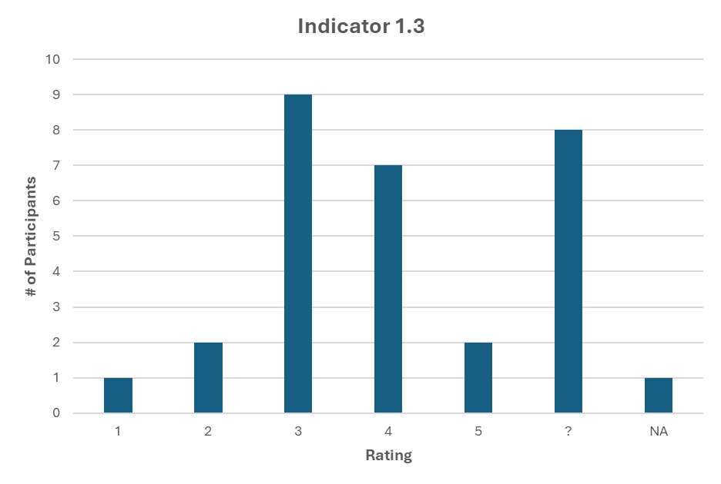
1.1 Your organization has formal policies and related documents (e.g., core values statement, organizational declaration) to ensure a safer, inclusive and equitable environment for all staff, volunteers, board members and service users.
If you collected responses before the meeting, you may wish to highlight specific indicators for discussion by showing a graph of responses. This can be important if there is a wide range of different responses, or (as shown here) lots of participants who responded ‘Unsure’.
Notes:
-**You may choose to duplicate this slide for other indicators.

Slide 13
Policies & Procedures
Optional slide for additional reflections or for participant annotation.
Notes:
-**You might use this as a place to ask participants additional questions, or to share additional reflections. For example, you may ask participants:
What indicator is most important to address?
What actions would you take based on the results of this section?
How does this section align with your role and responsibilities?

Slide 14
People & Culture
2.1 Ongoing improvement and accountability to address stigma are part of your organization’s culture.
2.2 Staff and volunteers (including leadership) can recognize, see and understand stigma in interpersonal interactions and organizational operations.
2.3 Leadership actively embodies organizational commitment to stigma reduction and equity (e.g., reinforces/creates supportive practices, approaches, policies and partnerships that promote equity and reduce stigma).
2.4 Your organization’s budget aligns with and commits to stigma reduction and equity, including: professional development, engagement of PWLE, supporting staff health and wellness, and collaboration with other organizations.
2.5 Your organization fosters a supportive environment for all staff and volunteers and intentionally recruits and provides meaningful opportunities for members of equity-deserving communities.
2.6 Protocols and processes are in place to support staff, volunteers, board members and service users and to acknowledge and address the impacts of stigma.
Notes:
Notes:
Here are the indicators included in Section 2: People and Culture
You might engage in discussion here, or use the next slide for annotation. If using next slide, you might post these indicators in the chat to reference during discussion
You might invite participants to share their ratings on these indicators (e.g., through chat, annotation, polls, show of hands)
If responses were collected ahead of time, you might share the average ratings for each indicator.

Slide 15
People & Culture
Optional slide for additional reflections or for participant annotation.
Notes:
-**You might use this as a place to ask participants additional questions, or to share additional reflections. For example, you may ask participants:
What indicator is most important to address?
What actions would you take based on the results of this section?
How does this section align with your role and responsibilities?

Slide 16
Organizational Spaces
3.1 The environment is comfortable, inviting and accessible.
3.2 Digital (e.g., website, social media platforms, virtual communication platforms) and physical spaces (e.g., reception area, waiting rooms) affirm and represent all service users.
3.3 Spaces are designed and used in a way that provides privacy.
3.4 Service users’, staff members’ and volunteers’ experiences and needs regarding the physical and digital environment are listened to and acted on.
Notes:
Notes:
Here are the indicators included in Section 3: Organizational Spaces.
You might engage in discussion here, or use the next slide for annotation. If using next slide, you might post these indicators in the chat to reference during discussion
You might invite participants to share their ratings on these indicators (e.g., through chat, annotation, polls, show of hands)
If responses were collected ahead of time, you might share the average ratings for each indicator.

Slide 17
Organizational Spaces
Optional slide for additional reflections or for participant annotation.
Notes:
-**You might use this as a place to ask participants additional questions, or to share additional reflections. For example, you may ask participants:
What indicator is most important to address?
What actions would you take based on the results of this section?
How does this section align with your role and responsibilities?

Slide 18
Programs & Services
4.1 Policies and procedures for programs and services promote respect, safety, equity and inclusivity.
4.2 Programs and services are available and accessible to a wide range of needs and populations.
4.3 Programs and services are evidence-based and reflect promising practices in inclusive, destigmatizing and person-centered care.
4.4 Community members, including PWLE of stigma, are involved in the design and delivery of programs and services.
4.5 Staff and volunteers deliver programs and interact with service users and community in a way that builds trust, rapport, safety, compassion and empathy.
4.6 Service users have choice and control over their participation in programs and services.
4.7 Programs and services are coordinated to promote holistic and continuous care.
Notes:
Notes:
Here are the indicators included in Section 4: Programs and Services.
You might engage in discussion here, or use the next slide for annotation. If using next slide, you might post these indicators in the chat to reference during discussion
You might invite participants to share their ratings on these indicators (e.g., through chat, annotation, polls, show of hands)
If responses were collected ahead of time, you might share the average ratings for each indicator.

Slide 19
Programs & Services
Optional slide for additional reflections or for participant annotation.
Notes:
-**You might use this as a place to ask participants additional questions, or to share additional reflections. For example, you may ask participants:
What indicator is most important to address?
What actions would you take based on the results of this section?
How does this section align with your role and responsibilities?

Slide 20
Evaluation, Improvement
& Accountability
5.1 Feedback is regularly collected from service users/community members, staff, and volunteers.
5.2 Feedback is collected with an awareness and respect for anonymity and confidentiality.
5.3 Consider the ways information collected can be analyzed, interpreted and actioned to address stigma and improve the experience of service users and staff.
5.4 Feedback is valued and considered when identifying areas for action/improvement and service users are engaged in implementing changes.
Notes:
Notes:
Here are the indicators included in Section 5: Evaluation, Improvement and Accountability
You might engage in discussion here, or use the next slide for annotation. If using next slide, you might post these indicators in the chat to reference during discussion
You might invite participants to share their ratings on these indicators (e.g., through chat, annotation, polls, show of hands)
If responses were collected ahead of time, you might share the average ratings for each indicator.

Slide 21
Evaluation, Improvement
& Accountability
Optional slide for additional reflections or for participant annotation.
Notes:
-**You might use this as a place to ask participants additional questions, or to share additional reflections. For example, you may ask participants:
What indicator is most important to address?
What actions would you take based on the results of this section?
How does this section align with your role and responsibilities?

Slide 22

Prioritizing Actions
Share 1-2 changes/actions that you would most like to see implemented as a result of the assessment process and discussion.
Notes:
Notes:
You might include a final reflection question or anonymous poll here for participants to share any final thoughts or takeaways.
Examples of questions/reflections include:
What is your biggest takeaway from this assessment process?
Share 1-2 changes/actions that you would most like to see implemented as a result of the assessment process and discussion.
In your opinion, what section/indicator is the biggest priority for action?

Slide 23
Moving Results into Action
Provide details on the next steps and how assessment participants will be involved in creating and/or implementing the Action Plan
Notes:
Notes:
Clarify the next steps in the assessment process and the role that Assessment Participants will have in developing/implementing the Action Plan
Speak to how these plans/commitments will be shared with those who have participated in the assessment and others

Slide 24

Remember...
Stigma can be found in nearly every aspect of an organization and takes time to meaningfully address
Small, incremental changes can have a big impact over time!
Notes:
Notes:
Acknowledge that this process may have identified lots of different areas for improvement across many levels/areas of the organization, and it’s possible that some people may be feeling discouraged.
They will not all be addressed immediately and that's ok – the purpose of the assessment tool is to encourage an ongoing, continuing process of reflection and action.
We are aiming to create small incremental changes that can have an impact long term.

Slide 25
Thank you!
________________
Questions?
Notes:
Notes:
Thank participants for taking part in the assessment process and joining the Debrief Meeting
Provide an opportunity for questions and clarify if there are other opportunities to share perspectives individually (e.g., email or meet with a member of the Working Group)

