Slide 1
The Pan-Canadian Health Promoter Competencies: Overview
Notes:
Updated December 2015

Slide 2
Purpose
Provide a brief overview of the Health Promoter Competencies:
What are the Health Promoter Competencies?
Why were they developed?
Who are they for?
How were they developed?
What do the competencies include?
What tools exist to support their use?
How have the competencies been used to-date?
How can I get more information?
Notes:
Intent of this slidedeck is to provide a succinct overview of the competencies by answering the listed questions.

Slide 3
What are the Health Promoter Competencies?
Describe what health promoters are expected to be capable of doing in the field of health promotion to:
Improve determinants of health
Improve health and health equity
Notes:
The Health Promoter Competencies describe what health promoters are expected to be capable of doing to work effectively, efficiently, and appropriately in the field of health promotion.
The set of Health Promoter Competencies is a framework for health promoters and others who use health promotion as an approach to improve health, health equity and the determinants of health.

Slide 4
The Health Impact Pyramid
Counselling
and Education
Clinical
Interventions
Long-Lasting Protective
Interventions
Changing the Context to Make
Individuals’ Default Decisions Healthy
Socioeconomic Factors
Increasing
Population Impact
Increasing Individual
Effort Needed
Source: Frieden TR. A framework for public health action: The health impact pyramid. Am J Public Health 2010; 100(4): 590-595.
Notes:
A common misunderstanding is to equate health promotion with the education and counselling of individuals. While such approaches play a role in individual-level care and services, from a population perspective, such approaches are limited by their potential reach, as well as whether social and physical environments support behaviour change and provide equitable opportunities for health.
As shown in the ‘Health Impact Pyramid’, the greatest potential for impacting health requires changes to these social and physical environmental contexts so that individual’s default (easy) decisions are healthy, and to address social determinants of health.

Slide 5
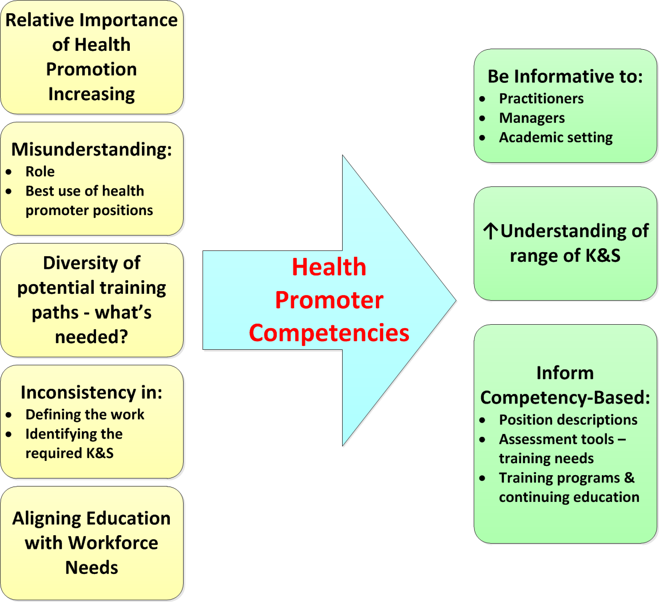
Why Were the Competencies Developed?
Notes:
There were several drivers for the development of the Health Promoter Competencies including:
increasing demand for practitioners with the knowledge, abilities, skills and values necessary to address the increasing complexity of health issues and burden of chronic diseases
increasing concern for health inequities
recognition of the importance of healthy public policies and creating supportive environments for health.
Also, a number of systemic challenges including:
misunderstanding of the role and best use of health promoter positions;
a lack of consistency in health promotion position descriptions;
a need to better align training programs and continuing education with workforce needs.
As such, the intent in developing the competencies was to be informative to practitioners (and others), increase understanding of the range of knowledge and skills that are needed for health promotion practice, and to inform competency-based workforce development including (position descriptions, assessment tools, & training).
Competencies are a basic building block for workforce development.

Slide 6
Who Are the Competencies For?
There are 3 target audiences:
Health promotion practitioners
Those that hire and manage health promoters
Academic institutions that provide academic programs and continuing education for health promoters

Slide 7
But What’s a ‘Health Promoter’?
A health promotion practitioner is someone whose main role and function is health promotion.
The competencies are designed to be relevant to all practitioners whose main role reflects the Ottawa Charter’s strategies and actions.
Notes:
Ottawa Charter for Health Promotion
Strategies:
Advocate for conditions favourable to health
Enable people to achieve their full health potential
Mediate between differing interests in society for the pursuit of health.
Actions:
Build healthy public policy
Create supportive environments
Strengthen community action
Develop personal skills
Reorient health services.
Note that there is considerable variation in health promoters’ job titles and they are potentially employed in a range of organizations. This includes not just public health organizations and NGOs, but also:
other health-related settings (e.g., mental health, primary health care, etc.)
non-health settings (e.g., municipalities, workplaces, school boards, etc.).

Slide 8
How Do These Competencies Relate to the Public Health Core Competencies?
Health Promoter Competencies build and expand upon the Core Competencies for Public Health
Notes:
Health Promoter Competencies build and expand upon the Core Competencies for Public Health:
Since health promotion is a core function of public health, all public health practitioners are expected to possess health promotion-related competencies. These are therefore included in the public health core competencies.
Since health promoters’ main role is health promotion, there is a greater depth and breadth of expectations for health promotion-related competencies.
Within the Health Promoter Competencies’ Toolkit, two levels of proficiency in the application of the competencies are described. This includes examples for each competency statement, as well as sample position descriptions.
The Toolkit also includes a side-by-side comparison of the Health Promoter Competencies with the Public Health Core Competencies.

Slide 9
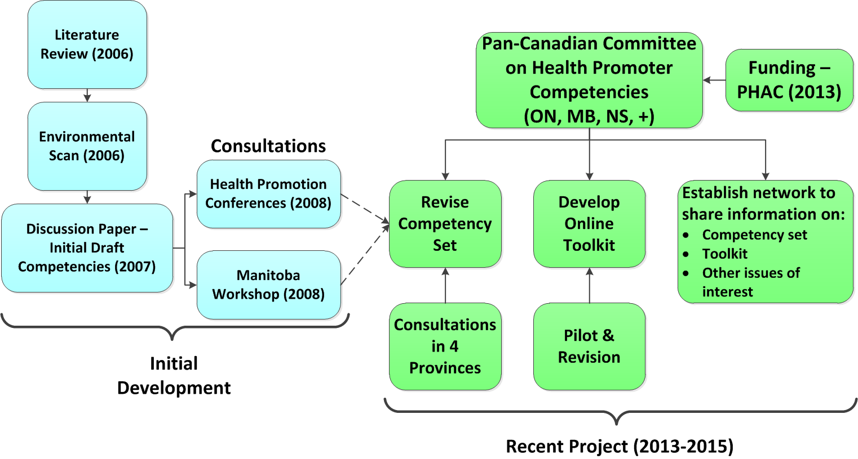
How Were the Competencies Developed?
Notes:
Initial development of the Health Promoter Competencies began in 2006. With support from the Public Health Agency of Canada (PHAC), Health Promotion Ontario produced a series of foundational documents that informed the development of an initial set of draft health promoter competencies in 2007. These were the subject of initial consultations with health promoters in 2008 at two health promotion conferences, as well as a preliminary consultation in Manitoba. No further work on the competencies occurred until a recent project completed in 2015.
A Committee of health promoters from three provinces received funding from PHAC in 2013 to conduct consultations in 4 provinces, develop an online toolkit to support the use of the competencies, as well as establish a network of health promoters to share information on the initiative. Interested parties from additional provinces involved with the project were invited to participate in the Committee.
Consultations occurred in Manitoba, Nova Scotia, British Columbia and Alberta. These were comprised of an online survey and in-person workshop in each province. Participants included health promoters, their managers and academic institutions. The feedback informed revisions to the competencies, as well as the content of the online toolkit. Feedback on a pilot version of the toolkit was used to make subsequent improvements. A network was built among project contacts that wished to receive updates on the project including revisions to the competencies and the release of the toolkit.
Additional details regarding the project including copies of foundational documents, provincial consultations, and access to the toolkit are available on the project’s website. (www.healthpromotercanada.com).

Slide 10
The Competencies Package
A preamble
Competency statements
Glossary
Online toolkit
Notes:
The Health Promoter Competencies package includes a preamble, the competency statements themselves, as well as a glossary for various terms appearing in the competency statements. An online toolkit is available to support use of the competencies.

Slide 11
Health Promoter Competencies 34 Statements in 9 Domains
Health Promoter Competencies
Health Promotion Knowledge & Skills
Communication
Diversity & Inclusiveness
Leadership & Building Organizational Capacity
Situational Assessments
Plan & Evaluate Health Promotion Action
Policy Development & Advocacy
Community Mobilization & Building Community Capacity
Partnership & Collaboration
Notes:
The competency set includes 34 statements organized in 9 domains.
As per any competency set, the statements are inter-dependent since the execution of a health promotion-related task will typically require the integration of multiple competencies (i.e., apply health promotion knowledge and skills, conduct a situational assessment, plan and evaluate action, communication, partnership, diversity, etc.).

Slide 12
What About Health Promotion Core Values and Principles?
The preamble to the competencies include the following core values and principles that guide health promotion practice:
a social-ecologic model of health that takes into account the cultural, economic, and social determinants of health
a commitment to equity, civil society and social justice
a respect for cultural diversity and sensitivity
a dedication to sustainable development
a participatory approach to engaging the population in identifying needs, setting priorities, and planning, implementing, and evaluating the practical and feasible health promotion solutions to address needs.
Notes:
Consultation participants stressed the importance of how the health promoter competencies are applied
From the Galway Consensus Conference, the list of health promotion core values and principles are included in the preamble to the competencies.

Slide 13
Using the Competencies
Competencies are a building block for workforce development and can be used for various tasks:
Creating a job profile to describe the health promoter role & to inform job descriptions
Creating a job description
Planning job interview questions
Competency based self-assessment
Planning to meet learning needs
Designing curriculum
Notes:
Employing health promoters may be new for some organizations or the nature of the expectations for existing positions may need to shift to reflect a greater emphasis on health determinants and inequities. There are various existing tasks that competencies can strengthen. For example:
Some organizations use a job profile to describe in some detail the role for particular practitioners, which is then used to inform job descriptions.
For either the job profile or job description, the competencies and related materials can be used to articulate the type of work that is expected of health promoters and the necessary knowledge, skills, values and attitudes.
Job interview questions should reflect the expectations for the position and its context.
Individual practitioners may wish to self-assess their competencies – perhaps against their current or a future desired position. Competency-based performance appraisals are also feasible. A learning/developmental plan can focus on prioritized gaps for continuing education.
For training, the curriculum of a program can informed by the competencies needed for practice.

Slide 14
Online Toolkit
An online toolkit provides a number of tools to support the practical use of the competencies.
There are 4 groups of tools:
Position profile
Practitioner tools
Manager tools
Additional tools
Notes:
To support use of the Health Promoter Competencies, an online toolkit has been developed.
To aid navigation on the website, the tools have been clustered into four groups.

Slide 15
Notes:
The position profile is a more detailed description of a health promoter position and can be used to develop position descriptions. It includes a brief description of the health promotion function and a summary of the health promoter role. It also provides a practice example for two levels of proficiency for each competency statement. This was in response to a frequent question during the consultation on the competencies from participants regarding the expected level of proficiency for the competencies.
A number of tools are grouped as ‘practitioner tools’ or ‘manager tools’, although anyone can look at the materials.
In the practitioner tools, a self-assessment tool has been provided, as well as a high level overview of strategies to develop competencies. During the consultations on the competencies, questions were made regarding examples of some of the health promoter outputs that are included in the competencies. The toolkit therefore provides some examples of briefs and other outputs.
In the group of manager tools, sample position descriptions are provided at two levels of health promoters. A set of sample interview questions, with model answers, are also provided. The self-assessment tool has also been modified for use as a performance appraisal template.
And finally, there are additional tools including a roadmap to aid finding a particular tool based on what one is trying to do. The side-by-side comparison between the health promoter competencies and the public health core competencies is also provided. As is a copy of this overview slidedeck.
The contents of the toolkit can be best appreciated by browsing the toolkit’s website.

Slide 16
How Have the Competencies Been Used To-Date?
Early application of the competencies over the course of the project included:
Adaptation of the competencies and the position profile (tool) to inform Nova Scotia's development of a province-wide position profile for health promoters
Application of the competencies in curriculum renewal efforts in multiple university health promoter programs
Application of the competencies in professional development events –
Early mapping by Public Health Ontario of existing health promotion skill building resources to the competency statements
Interest by health promoters at the Department of National Defence in utilizing the competencies to better describe and organize their work.
Notes:
University programs applying the competencies in their curriculum renewal efforts included: Dalhousie University (undergraduate program); University of Toronto (MPH), and the University of Alberta (MPH)
Professional development events: Manitoba association of health promoters (2015); NCCDH presentation at the University of Alberta (2015)

Slide 17
More Information
The project to validate and revise the health promoter competencies formally ended in December 2015
The project materials including the competencies, foundational documents, provincial consultation reports, and online toolkit will remain available at www.healthpromotioncanada.ca
A group of health promoters from across the country will continue to look for opportunities to support workforce development efforts for health promoters.

